Slide 1
Engaging Native Youth in Prevention
A webinar by Community Anti-Drug Coalitions of America (CADCA) in collaboration with the White House Office of National Drug Control Policy (ONDCP)

Slide 2
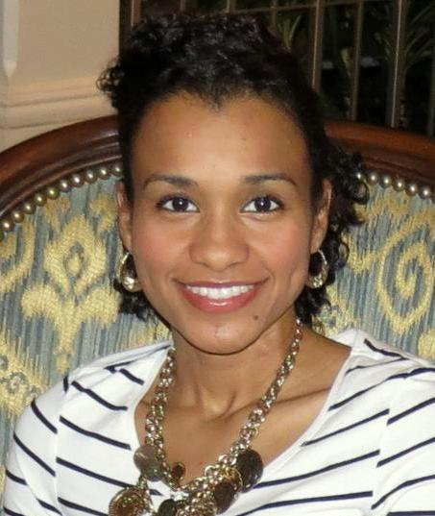
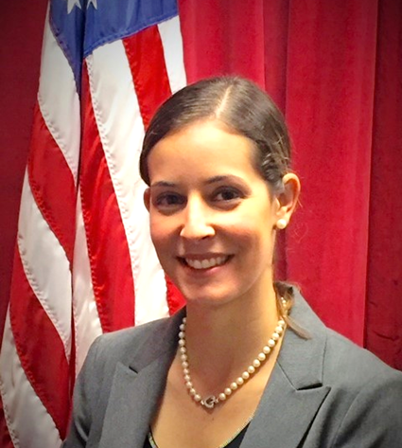
Welcome
Jasmine Carrasco
Youth Programs Manager
Community Anti-Drug Coalitions of America (CADCA)
Helen Hernandez
DFC Program Administrator
White House Office of National Drug Control Policy (ONDCP)

Slide 3
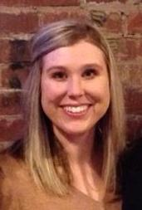
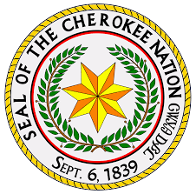
Moderator
About Lindsey:
9 years of experience in coalition and prevention work
Director of Prevention for Neighbors Building Neighborhoods serving a four county region in Muskogee
Certified SAPST Trainer for the State of Oklahoma
Previous Coalition Coordinator for the Muskogee Community Anti-Drug Network, a sub-recipient coalition with the Cherokee Nation
Lindsey Roberts, MPS, ICPS
NYLI Adult Trainer
Cherokee Nation
Muskogee, OK

Slide 4
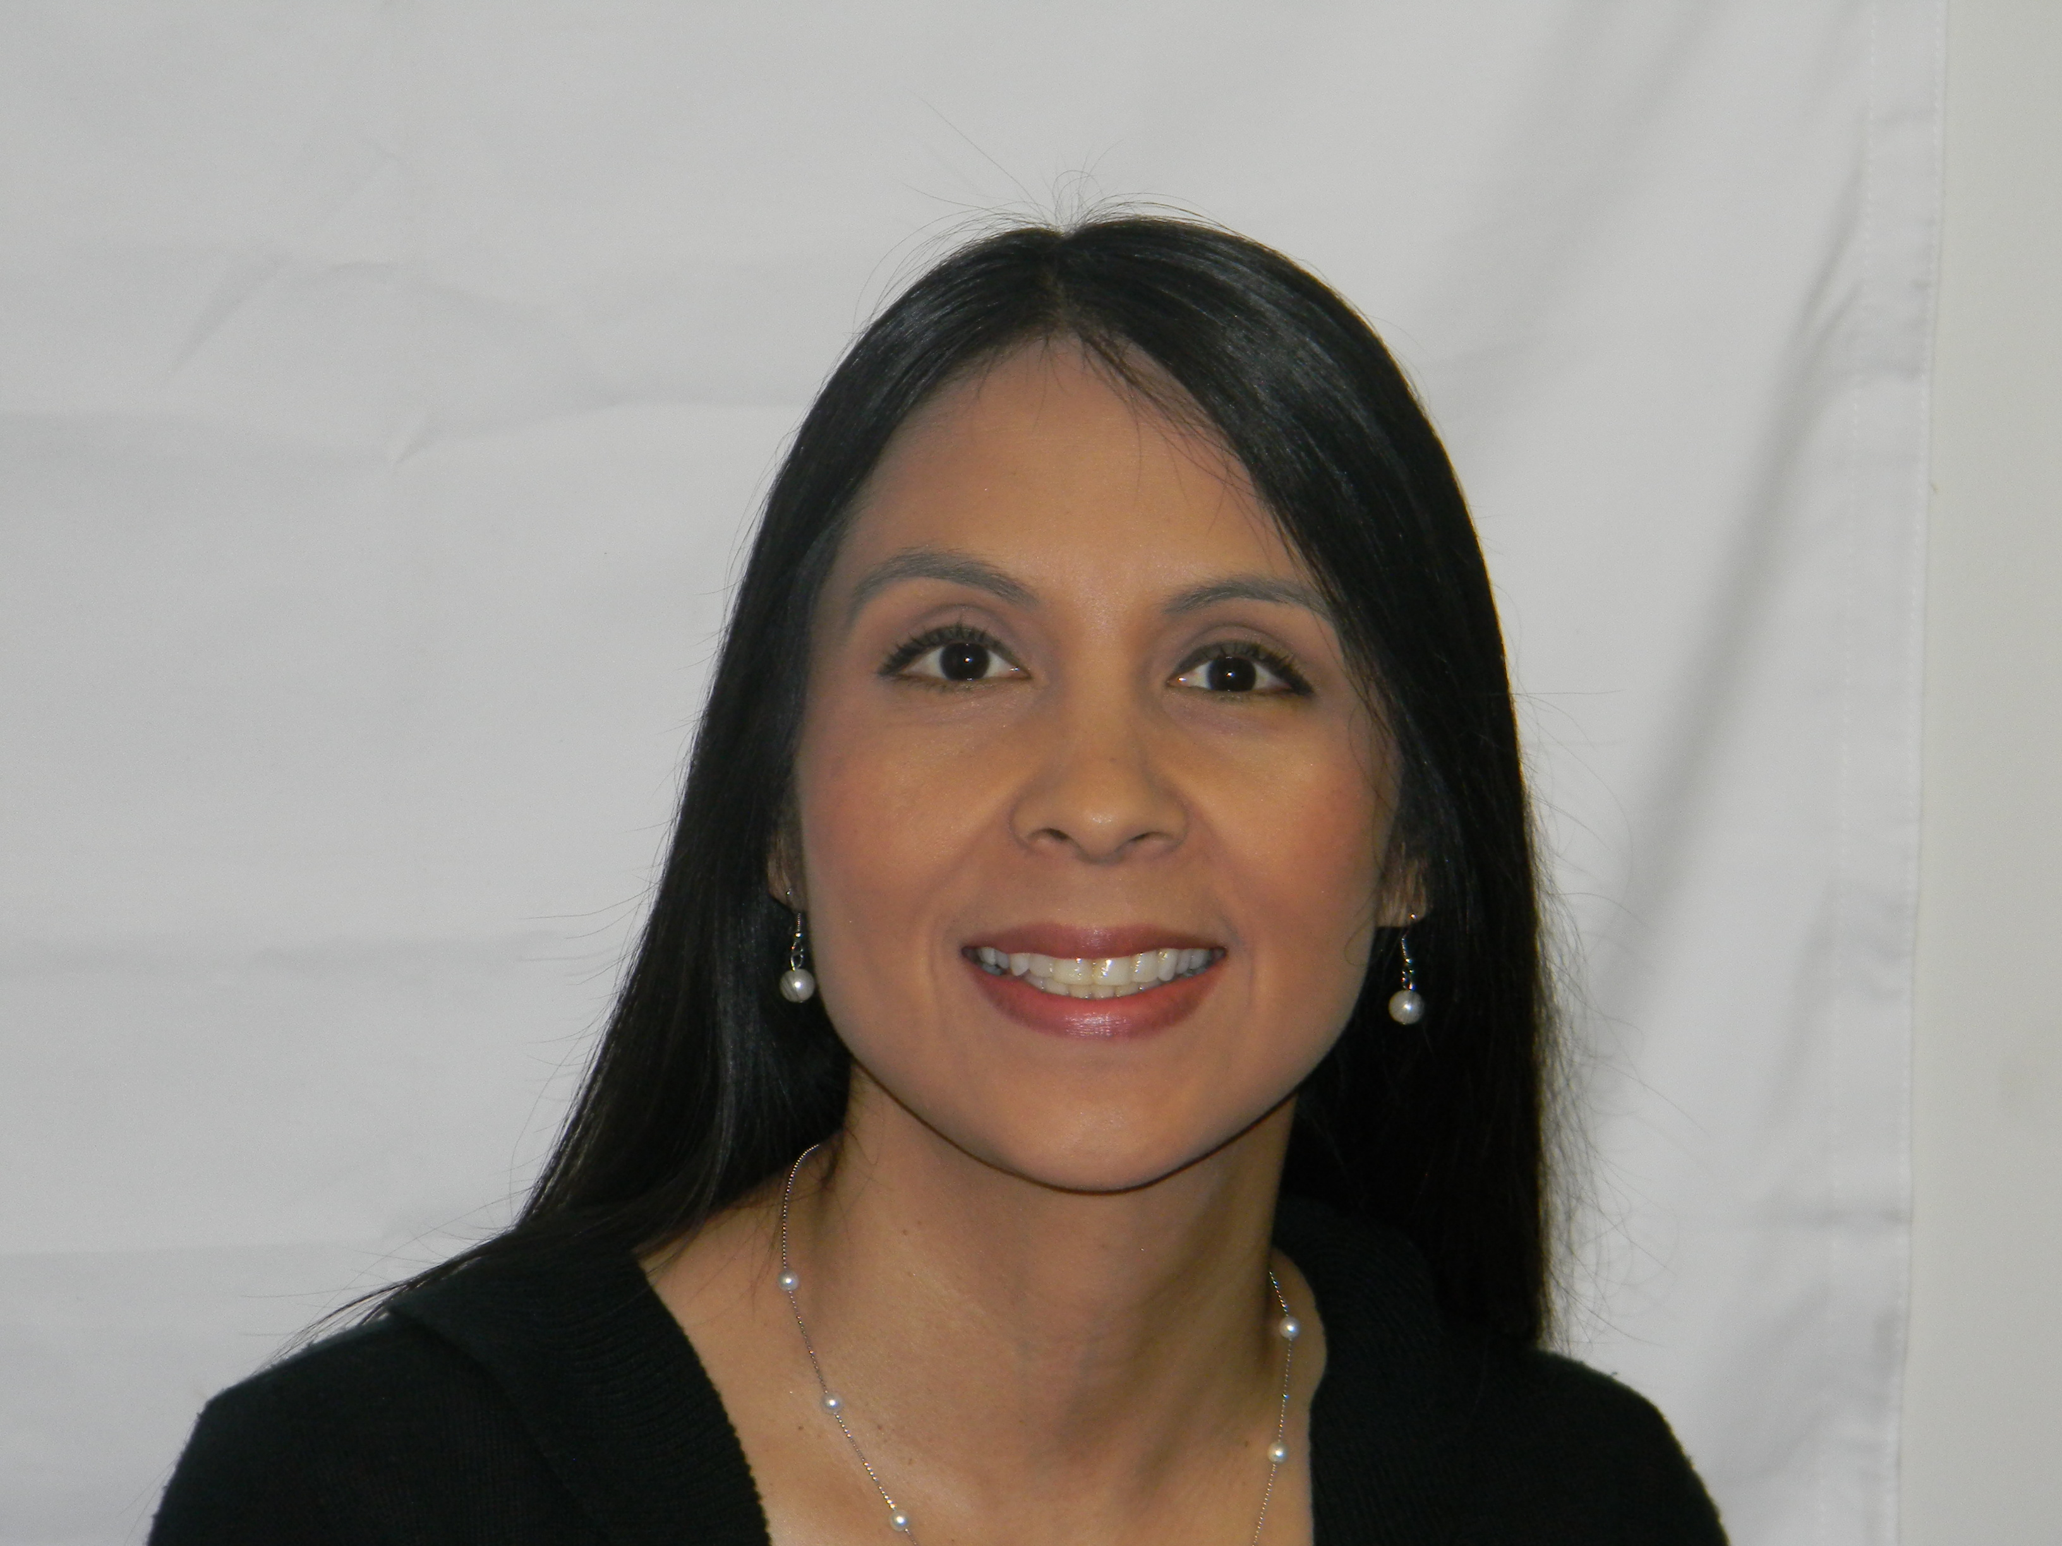
Adult Coalition leader
About Thomasine:
Licensed alcohol and drug counselor, providing culturally competent substance abuse prevention and treatment services in northeastern OK
Serves 11 counties, non-reservation and 39 tribes
Coordinates SAMHSA funded grant projects within the underserved Native American population
Active member of the Okmulgee County Wellness Coalition, OSU Center for Health Science Area Prevention Resource Center Coalition, and Mvskoke (Creek) Nation Youth Services Advisory Board
Thomasine Fife
Youth Wellness Coordinator/Clinician
Muscogee (Creek) Nation
Department of Health
Okmulgee, OK

Slide 5
Youth Coalition leader
About Jay:
Sophomore at Preston High School
Active member of Native American Student Association
Second Speaker of Mvskoke Nation Youth Council
Studies Creek, Chickasaw and Apsaalooke tribal languages and traditions
Jeffrey Scot (Jay) Fife, Jr.
Mvskoke (Creek) Nation Youth Council
Okmulgee, OK

Slide 6
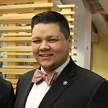
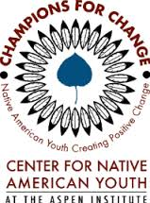
Youth Coalition leader
Lopez and San Juan Island Prevention Coalitions, WA
Coalition Profile:
Serves a very small rural island
Island-wide coalition (pop. 2500)
Targets youth from 2 schools
D.R.E.A.M. Team
Teddy McCullough, Policy Fellow
Center for Native American Youth
Coyote Valley Band of Pomo
Lopez and San Juan Island Prevention Coalitions, WA

Slide 7
Introductions and Objectives
Objectives of Today’s Webinar
Explore the data on native youth substance use
Become more aware of native culture and its importance when looking to engage native youth and their families
Evaluate coalition readiness to engage native Youth
Identify strategies to engage native Youth in coalition work

Slide 8
Polling for Facts #1

Slide 9
Polling for Facts #2

Slide 10
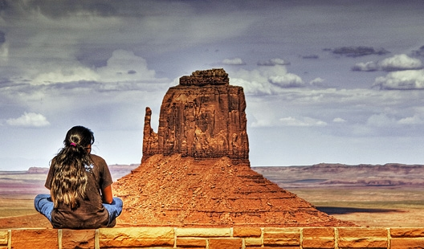
Monitoring the data
Without as many ways to occupy themselves on Indian Country or in their communities, native youth are more likely to become involved with drugs and alcohol out of peer pressure and easy access.
Access to alcohol may be easier for native youth to find than after-school activities.
(Center for Native American Youth at the Aspen Institute Voices of Youth Report, 2014)

Slide 11
Monitoring the data
Alcoholism in the Native/Tribal Community
Alcoholism mortality rates are 514% higher amongst Native/Tribal populations than in the general population
(The Indian Health Service fact sheets, 2011)

Slide 12
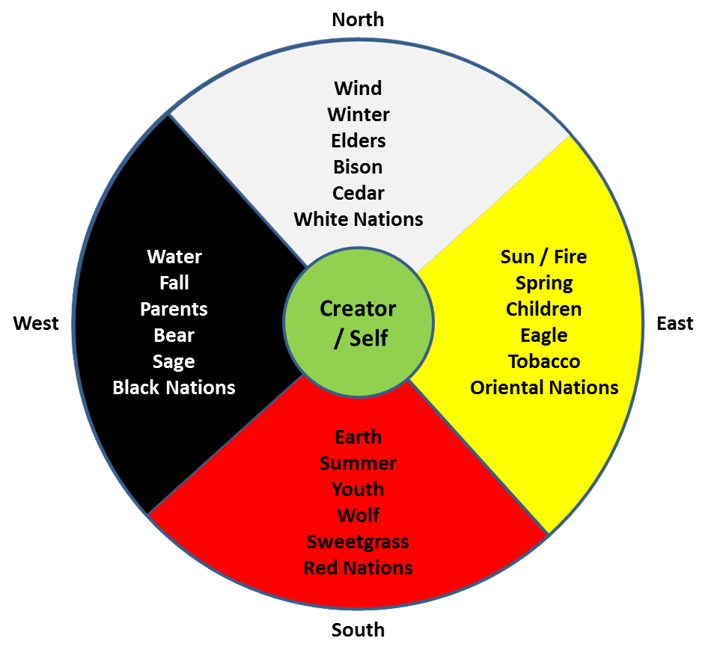
Monitoring the data
Historical Trauma
Rates of substance abuse disorders and other mental health disorders, particularly depression, are also elevated due to historical trauma (e.g., Beals, et al, 2001).
Beals, J., Novins, D. K., Mitchell, C., Shore, J. H., & Manson, S. M. (2001). Comorbidity between alcohol abuse/dependence and psychiatric disorders: Prevalence, treatment implications, and new directions among American Indian populations. In P. Mail (Ed.), National Institute on Alcohol Abuse and Alcoholism Monograph. Washington, DC: U. S. Government Printing Office. Comorbidity between alcohol abuse/dependence and psychiatric disorders: Prevalence, treatment implications, and new directions among American Indian populations.
Notes:
Thomasine—well versed in generational trauma
In 2009-2012, 56.2 percent of American Indian 8th graders and 61.4 percent of those in 10th grade had used marijuana, compared to 16.4 percent of 8thgraders and 33.4 percent of 10th graders in the MTF survey. American Indian students’ annual heroin and Oxycontin use was about two to three times higher than the national averages in those years.
High substance use in American Indian communities contributes to a range of social problems including violence, delinquency, and mortality from suicide or alcohol or other substance abuse. Thus these findings alert us to the urgency of implementing prevention programs in these communities. Moreover, given that American Indian youth are already using drugs and alcohol at high levels by the time they become teenagers, we clearly must do more to intervene at an earlier age. (NIDA Article: Substance Use in American Indian Youth Worse Than We Thought, 2014).
https://www.drugabuse.gov/about-nida/noras-blog/2014/09/substance-use-in-american-indian-youth-worse-than-we-thought

Slide 13
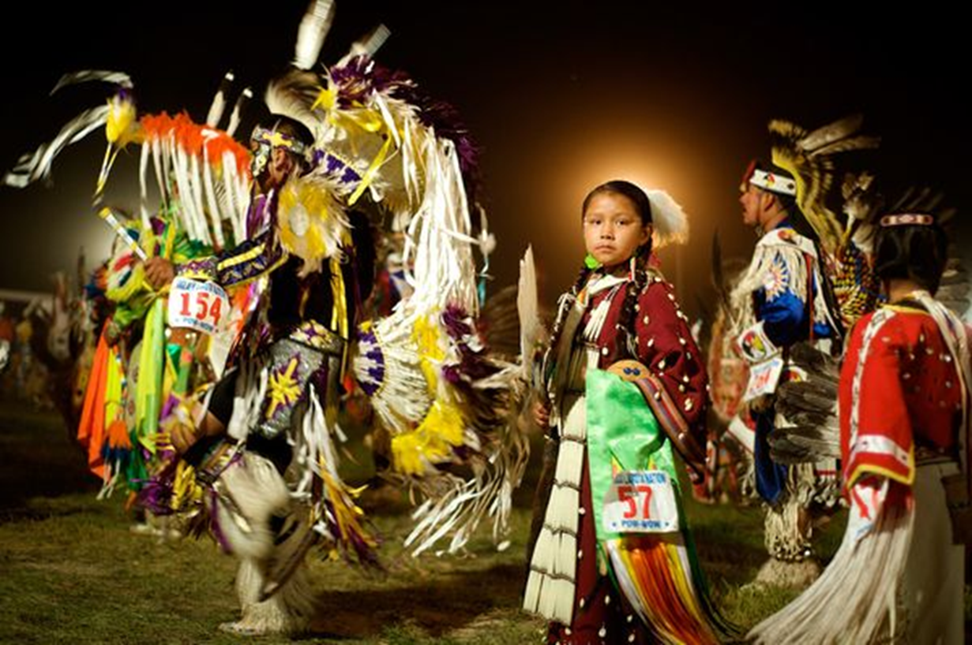
CULTURAL OBSERVATIONS
American Indians and Alaska Natives pride themselves greatly on their heritage. Many natives stay deeply involved with cultural traditions and religion throughout life to keep traditions alive and thriving.
Notes:
70% of those who identify as Native do not live on reservations

Slide 14
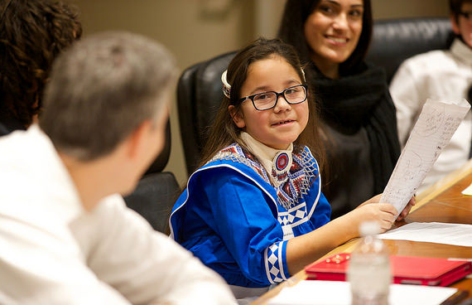
CULTURAL OBSERVATIONS
Youth want more responsibility by being included in decision-making and developing partnerships with their tribal leaders.
Native youth want to share their culture with non-Native members of their community.
(Center for Native American Youth at the Aspen Institute Voices of Youth Report, 2014)
Notes:
The organization Teddy works for now, the Center for Native American Youth, is responsible for this report. You may refer to him to speak to it more or wait until the end when we get to resources.

Slide 15
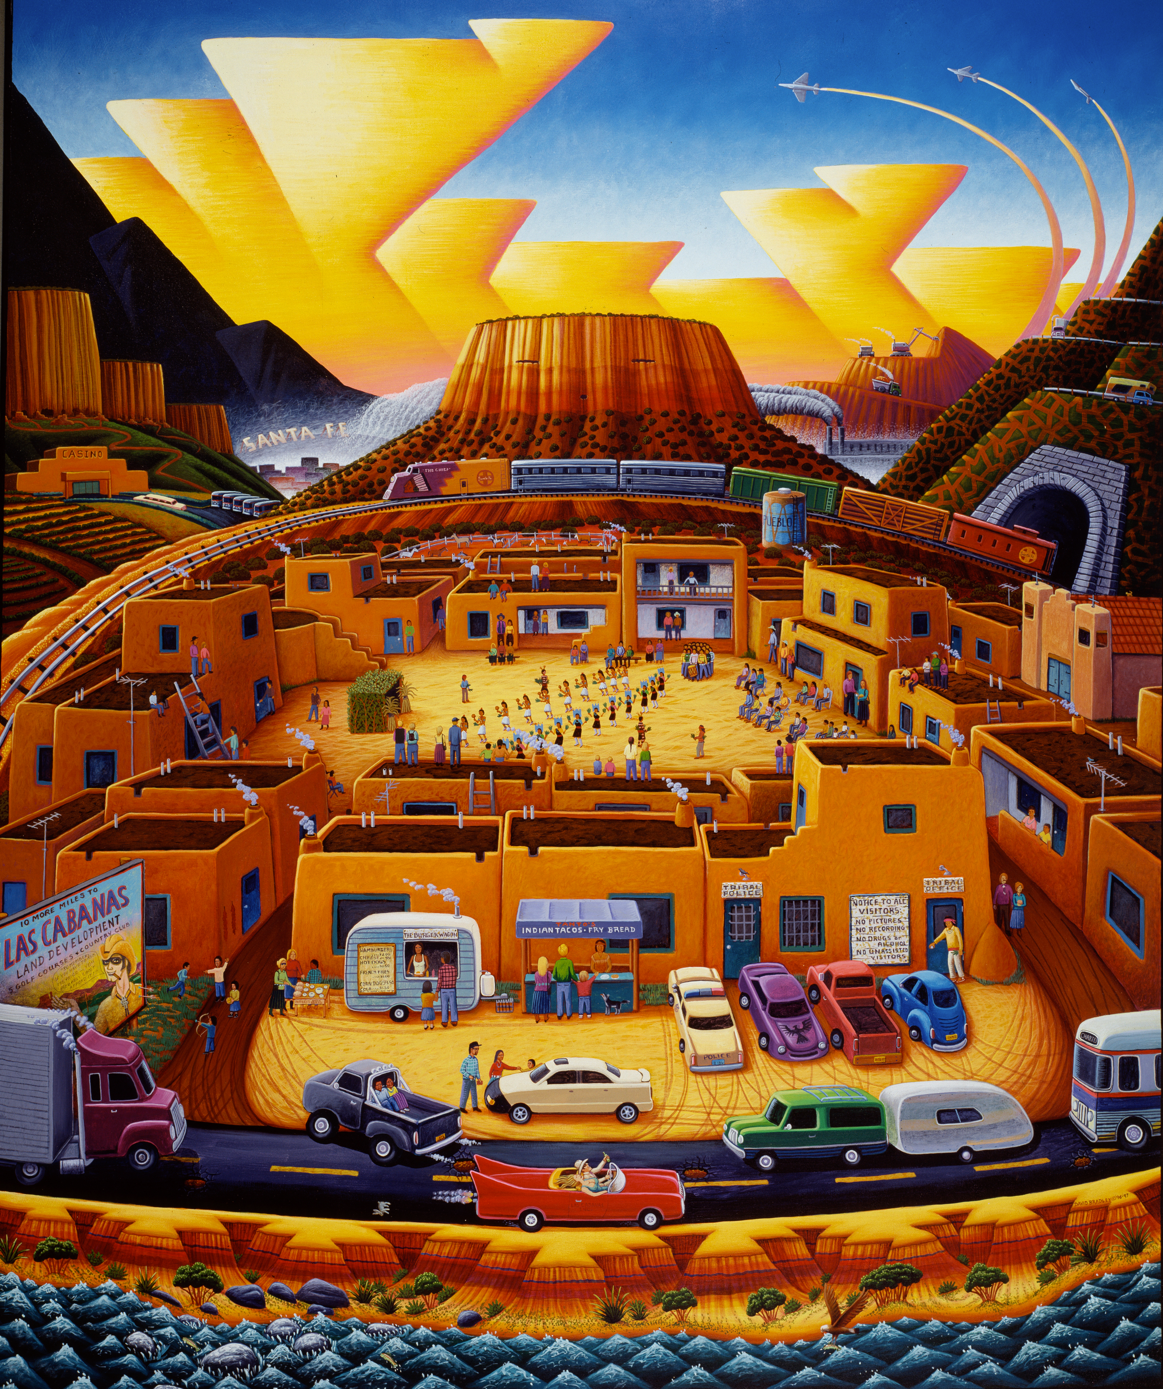
MOVING FORWARD
Connect With Community
Involving native youth in healthy community events, after school programs and other healthy activities can reduce their risk of getting involved with alcohol and drug abuse.

Slide 16
MOVING FORWARD
Respecting A Culture
Joining together and sharing in their passions may go a long way
Embrace the cultural differences and consider how they might add to the unique qualities of the coalition
Be AUTHENTIC in your approach to creating an inclusive and nonjudgmental environment within your coalition
Notes:
The joke we tell in our community…

Slide 17
Moving forward
Offer Alternative Resources
Native people have the highest prevalence of tobacco use of any population in the US, and many get started before the age of 15.
Cigarette smoking among American Indian/Alaskan Native males and females ages 12-17 years old is higher than any other ethnicity at 15.2%.
(National Survey on Drug Use and Health (NSDUH) Surveys 2008-2010)
American Indian and Alaska Native death rates were nearly 50% greater than rates among non-Hispanic whites during 1999-2009, with cancer and heart disease as lead causes.
(Center for Disease Control & Prevention , 2014)
Notes:
Other analyses of NSDUH data (2002–2003 to 2007–2008) showed that American Indian/Alaskan Native youth have experienced especially sharp declines in current cigarette smoking in recent years, which suggests that some progress has been achieved in reducing disparities in cigarette smoking in this racial/ethnic group (Garrett et al. 2011).
Thomasine--Educating in the clinical setting

Slide 18
Insights from Coalition Youth Leader
Successful attempts made by the coalition to engage youth
How youth involvement helped the coalition get to greater outcomes?
How can coalitions use the Center for Native Youth as a resource in their coalition’s efforts?
Teddy McCullough, Policy Fellow
Center for Native American Youth
Coyote Valley Band of Pomo
Lopez and San Juan Island Prevention Coalitions, WA

Slide 19
Insights from Thomasine and Jay
Strategies that the coalition took to engage native youth
What outcomes the coalition has been able to achieve with youth
Recommendations for engaging native youth within predominantly white communities
Thomasine and Jay Fife
Muscogee (Creek) Nation Youth Services
Okmulgee, OK

Slide 20
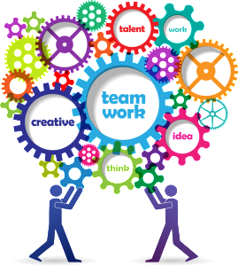
Next Steps
What’s realistic?
Plans of Action

Slide 21
Polling for Facts #3

Slide 22
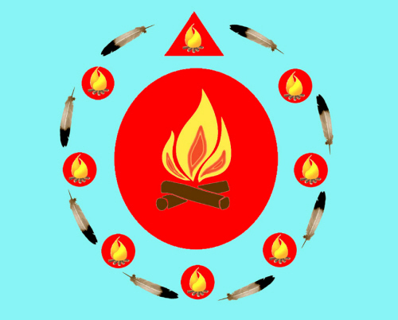
Closing and Questions
The Talking Circle

Slide 23
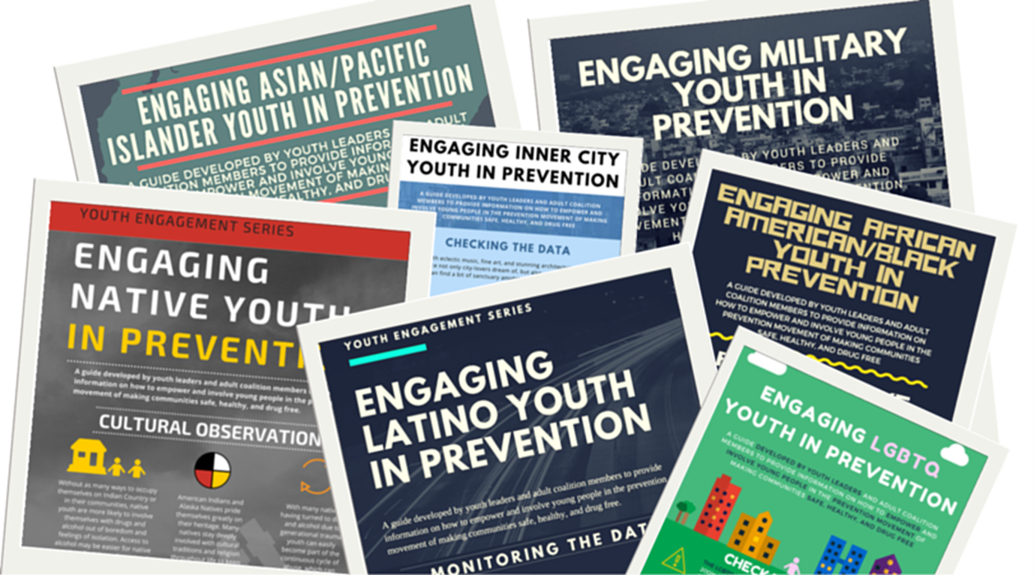
UPCOMING YOUTH ENGAGEMENT WEBINARS
LGBTQ
Military
Inner City
African American
www.cadca.org/youthengagement

Slide 24
FIND TODAY’S WEBINAR
All webinars and fact sheets will be archived on our website afterwards at http://www.cadca.org/youthengagement.
For help: Ian Solnosky at isolnosky@cadca.org or 1800.54.CADCA x260

Slide 25
connections
Center for Native American Youth
Creek Nation Behavioral Health
Email: cnayinfo@aspeninstitute.org
Website: www.cnay.org
Facebook: Center for Native American Youth Twitter: Center4Native
Contact: Thomasine.Fife@creekhealth.org
Social Media: https://www.facebook.com/MvskokeYouth/
Notes:
Center for Native Youth
Voices of Youth Report
Native Youth 101
Fast Facts

Slide 26
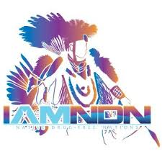
Other Resources
www.wernative.org
www.reconnectingthecircle.com
www.iamndn.org

Slide 27
Thanks for joining us!
Check the CADCA website for updates on upcoming sessions and to register for other Youth Engagement webinars!

