Slide 1
Engaging Latino/Hispanic Youth in Prevention #cadcayes
A webinar by Community Anti-Drug Coalitions of America (CADCA) in collaboration with the White House Office of National Drug Control Policy (ONDCP)

Slide 2
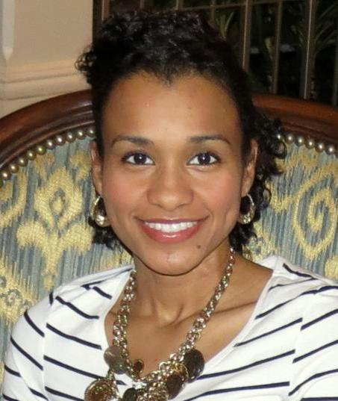
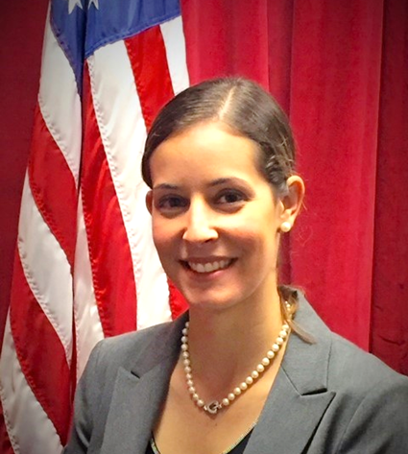
Welcome
Jasmine Carrasco
Youth Programs Manager
Community Anti-Drug Coalitions of America (CADCA)
Helen Hernandez
DFC Program Administrator
White House Office of National Drug Control Policy (ONDCP)

Slide 3
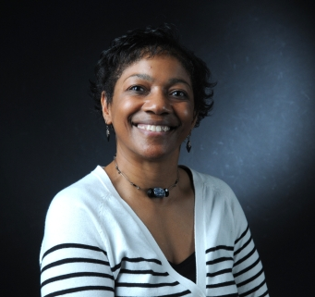
Moderator
About Yvonne:
25+ years experience in social services including substance abuse prevention, treatment and recovery
Drug and Alcohol Representative for the Council on Chemical Abuse
Advisor and active member on many county-wide committees and task force promoting cultural diversity awareness and drug and alcohol prevention (i.e. schools, law enforcement, youth, and recovery)
Yvonne Stroman
NYLI Adult Trainer
Reading, PA

Slide 4
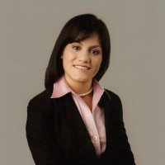
Adult Coalition leader
Coalition Profile:
Serves a community in the East Bay sub region of the San Francisco Bay Area
City-wide coalition
Targets youth from five middle schools & four high schools
DFC Funded, Year 3
Thania Balcorta, Program Manager
Eden Youth and Family Center
Hayward County for Healthy Youth
Hayward, CA

Slide 5
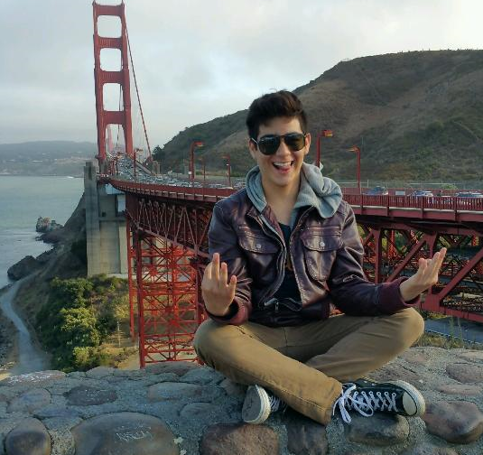
Youth Coalition leader
Coalition Profile:
Serves a small rural city
City-wide coalition
Targets youth from 2 schools K-12th grade and 2 charter schools
Hector Luna
Board of Directors Youth Member
Action Network
Point Arena/Gualala, CA

Slide 6
Introductions and Objectives
Objectives of Today’s Webinar
Learn about the increase and growth of the Hispanic Population
Evaluate coalition readiness to engage Latino/Hispanic Youth
Identify strategies to engage Latino Youth in coalition work

Slide 7
Polling for Facts #1

Slide 8
Polling for Facts #2

Slide 9
Monitoring the Data
Hispanic 8th graders tend to report the highest rates of use out of the three major racial/ethnic groups on nearly all classes of drugs
(Monitoring the Future, 2015)

Slide 10
Monitoring the Data
Drug abuse concerns facing Hispanics are complicated by
-Demographic Trends
-Low Economic Status
-Lack of Access to Health Care
-Environmental Risk Factors
(National Hispanic Science Network, 2012)

Slide 11
Monitoring the Data
What does your community data say about Latinx youth drug abuse?

Slide 12
Population Growth
US Census projections indicate that Hispanics will account for over half of the country's total population growth by 2020 and nearly 85% by 2060.
#cadcayes
Notes:
With high use rates and a steady increase in population, it is critical to include Latino youth in coalition efforts to reduce substance abuse among young people. Here are a few strategies to effectively and appropriately engage Latino youth in coalitions

Slide 13
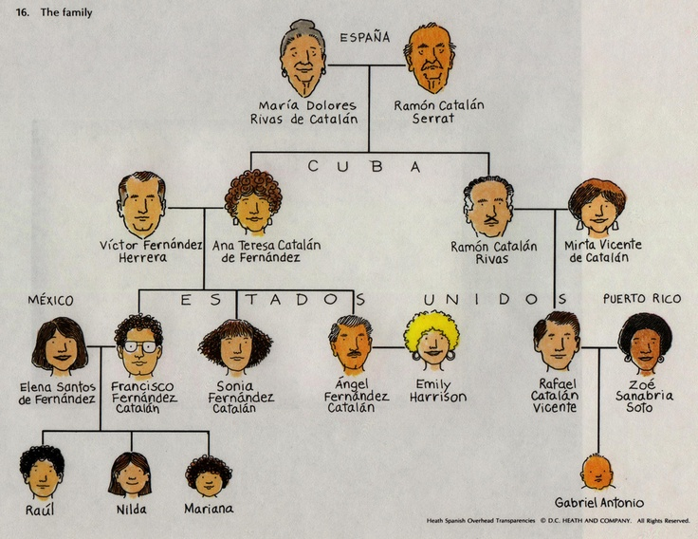
By Effective Means Necessary
Connect with Family
In Latino culture, family is a high priority. Meet with families over coffee or dinner to discuss their child's involvement in prevention
#cadcayes

Slide 14
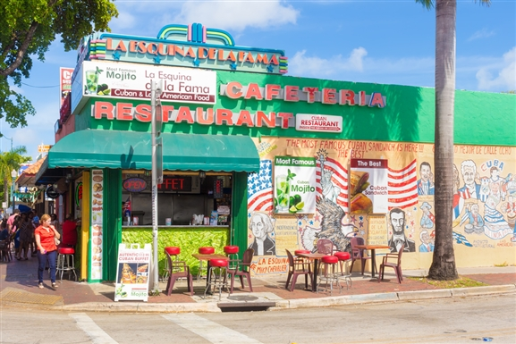
By Effective Means Necessary
Meeting Location
Consider having your next coalition meeting or community-wide event in another part of town. Making your coalition accessible could mean the difference in your diversity efforts.

Slide 15
By Effective Means Necessary
Cultural Humility
Language
Embrace cultural differences and consider how they might add to the unique qualities of the coalition. Be authentic in your approach to creating an inclusive and nonjudgmental environment within your coalition.
In anything, communication is key. Learn how your coalition can bridge possible language barriers. Where your language is spoken, is where you'll probably feel the most comfortable.

Slide 16
By Effective Means Necessary
Technology
Think of those technologies that will assist in your efforts to engage more Latino youth and their families (i.e. Google Translate, What’s App, Skype etc.)

Slide 17
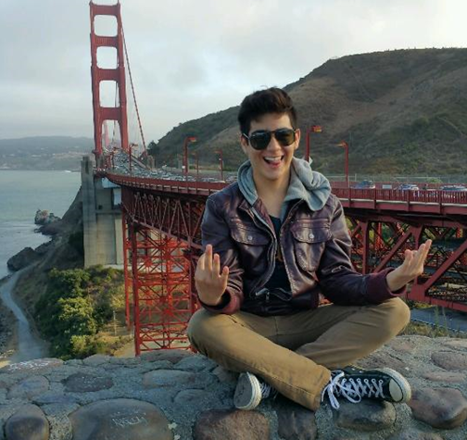
Insights from Coalition Youth Leader
Successful attempts made by the coalition to engage youth
How youth involvement helped the coalition get to greater outcomes?
How many Latinx youth have been involved in the coalition’s efforts?
Hector Luna, Youth Leader
Action Network
Point Arena/Gualala, CA

Slide 18
Insights from Coalition Adult Leader
What have you done to engage Latinx youth?
Thania Balcorta, Program Manager
Eden Youth and Family Center
Hayward County for Healthy Youth
Hayward, CA

Slide 19
Next Steps
What’s realistic?
Plans of Action

Slide 20
Polling for Facts #3

Slide 21
Closing and Questions

Slide 23
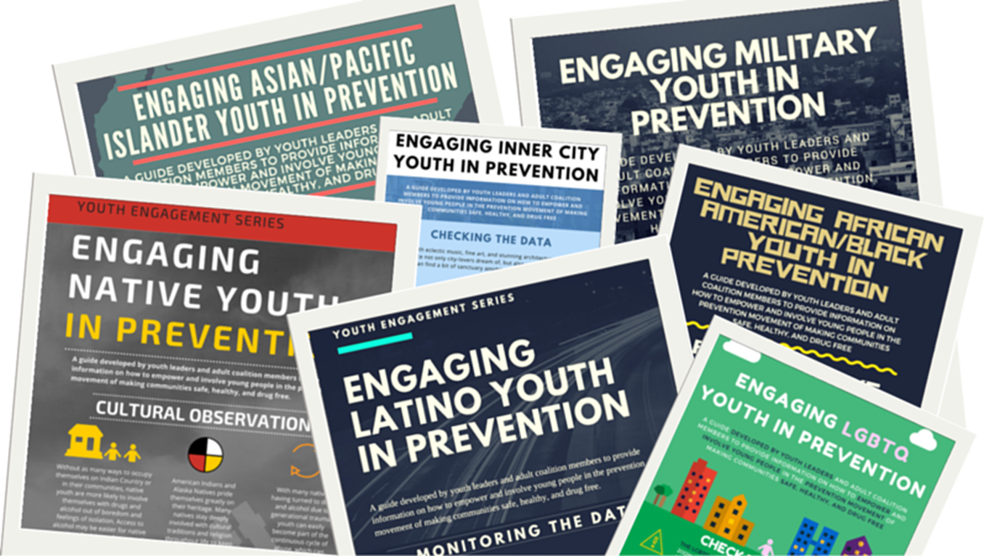
UPCOMING YOUTH ENGAGEMENT WEBINARS
LGBTQ
Military
Inner City
African American
www.cadca.org/youthengagement

Slide 24
FIND TODAY’S WEBINAR
All webinars and fact sheets will be archived on our website afterwards at http://www.cadca.org/youthengagement.
For help: Ian Solnosky at isolnosky@cadca.org or 1800.54.CADCA x260

Slide 25
connectionS
Hayward County for Healthy Youth
Action Network
Frances Anderson
707-884-5413
frances@ActionNetwork.info
http://www.actionnetwork.info/
AwakeCampaign
@Awake_campaign
@AwakeCampaign
Makeyourmark510
and HCHY08

Slide 26
Thanks for joining us!
Check the CADCA website for updates on upcoming sessions and to register for other Youth Engagement webinars!

